Slide 1
Creating a game
Part 1

Slide 2
Who am i?
My name is Bret Stateham
I work for Microsoft as a Technical Evangelist
You can find me at:
Email: Bret.Stateham@Microsoft.com
Blog: BretStateham.com
Twitter: @BretStateham
YouTube: youtube.com/Bstateham
Channel 9: channel9.msdn.com/niners/BretStateham

Slide 3
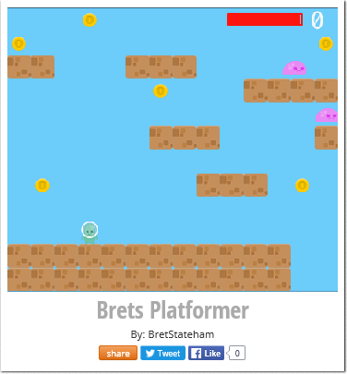
What are we going to make?
A “PLATFORMER” GAME!
Try mine out at http://aka.ms/BretsPlatformer

Slide 4

We’ll use flowlab.io
http://flowlab.io

Slide 5
Lots of other game engines
We are using flowlab.io because:
You can sign up for free and create up to 3 games at a time
You don’t have to install anything
You can easily see the code from others
The concepts you learn here will apply to other game engines
Want something a little more complex? Check “Construct 2” from scirra.com
Want something a lot more complex, but really powerful? Check out “Unity 5” from Unity3D.com

Slide 6
LOGIN into http://flowlab.io
First, make sure you know your “SEAT NUMBER”
Open Google Chrome and go to http://flowlab.io
User Name: “GameStudentXX@outlook.com” (where “XX” is your two digit “SEAT NUMBER”)
Password: Game0216 (capital “G”, and a zero)
If you prefer to create your own login, that is fine

Slide 7
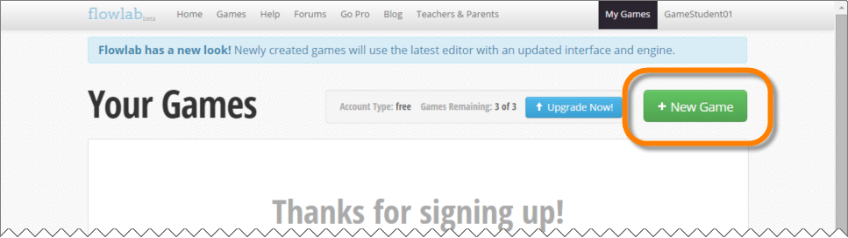
Create a new game

Slide 8
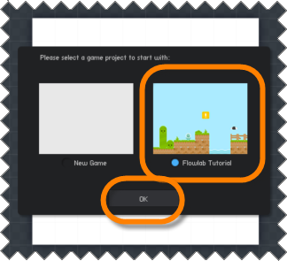
choose “flowlab tutorial” game

Slide 9
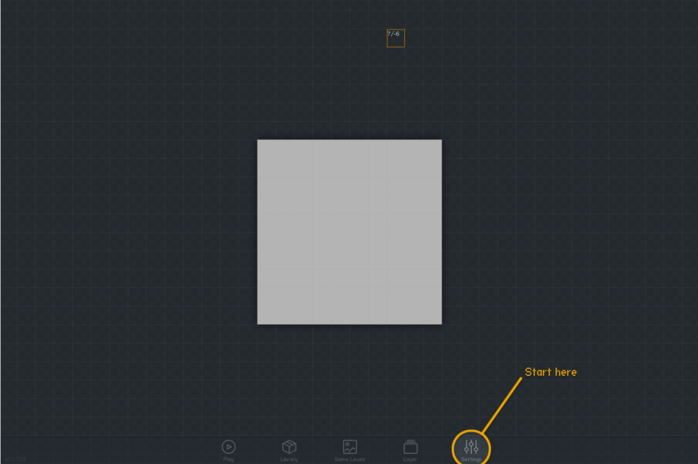
Follow along with me

Slide 10
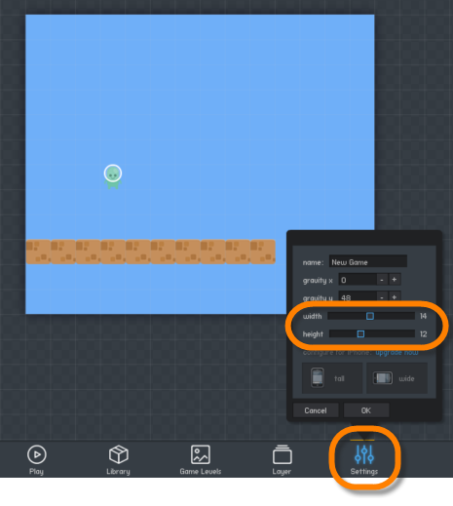
Let’s make it bigger
Width: 14
Height: 12

Slide 11
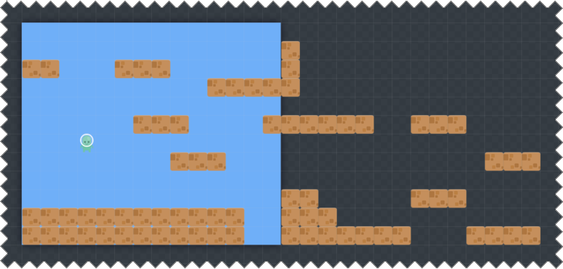
CREAT A BETTER PLATFORM LAYOUT

Slide 12
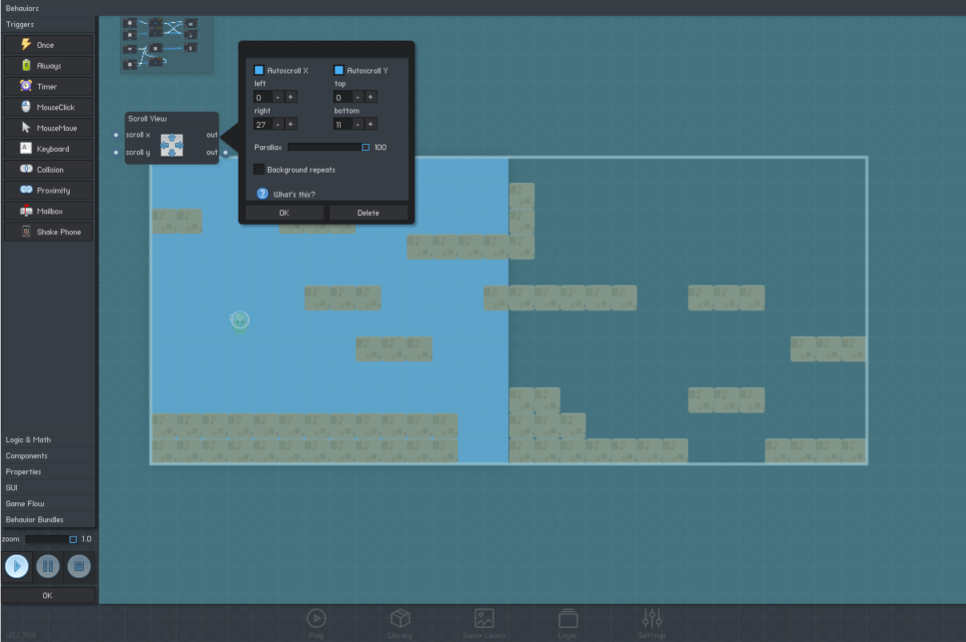
Add the scroll viewer tO PLAYER

Slide 13
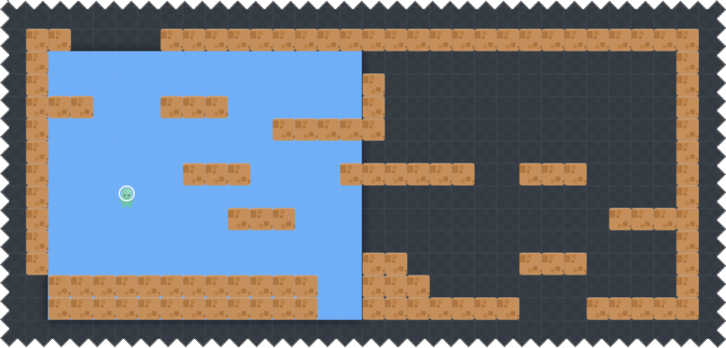
ADD BOUNDARIES

Slide 14
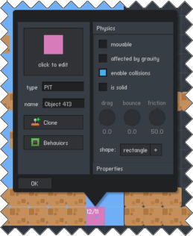
Create pits

Slide 15
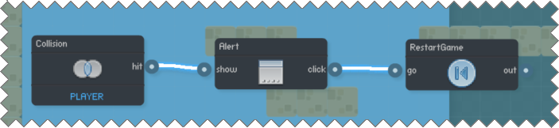
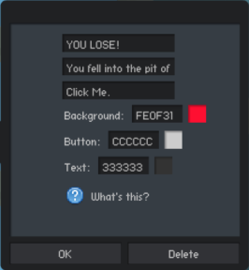
Add pit collision logic

Slide 16
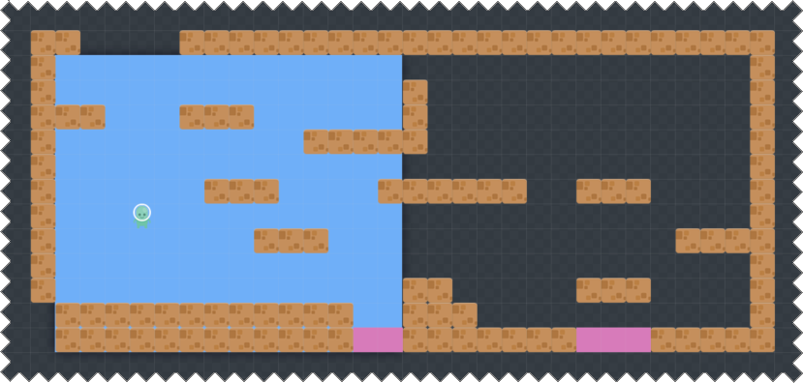
Fill the pits in

Slide 17
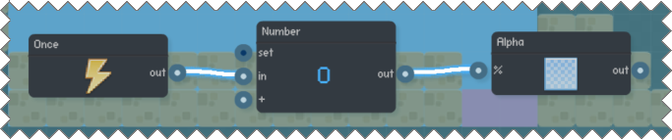
Add behavior to hide pits

Slide 18
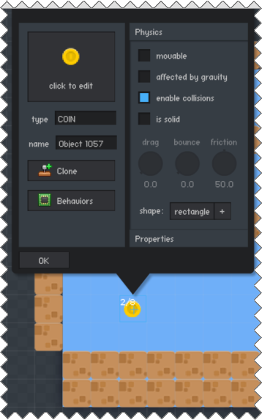
Add the coin

Slide 19
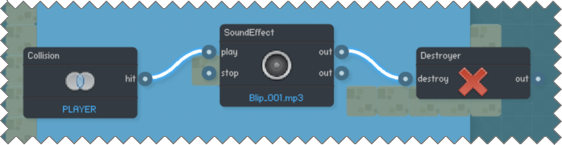
Add logic to the coin

Slide 20
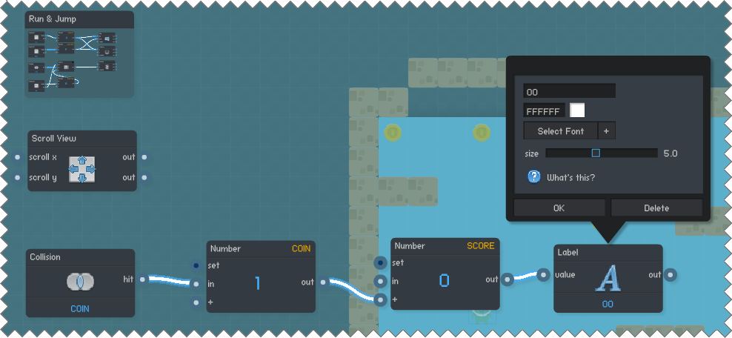
Add coin to player score

Slide 21
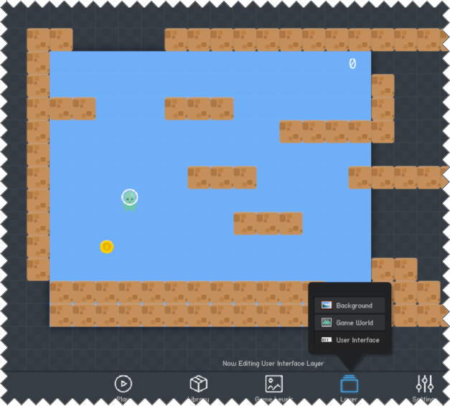
Position score label

Slide 22
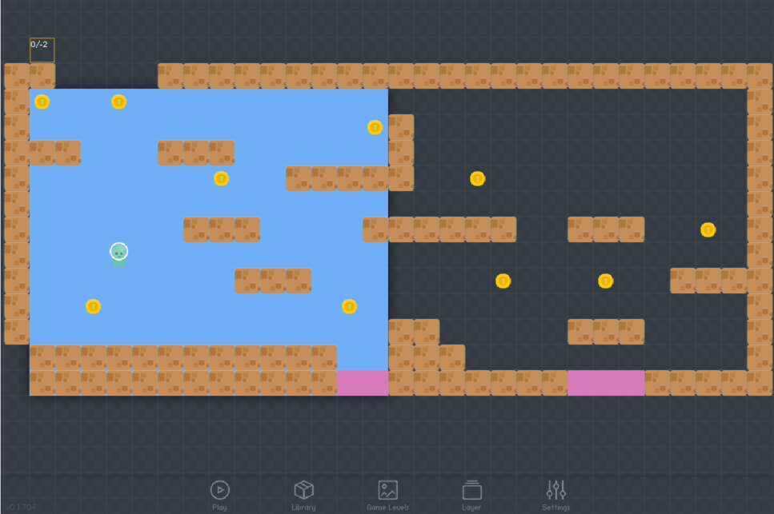
Add a total of ten coins

Slide 23
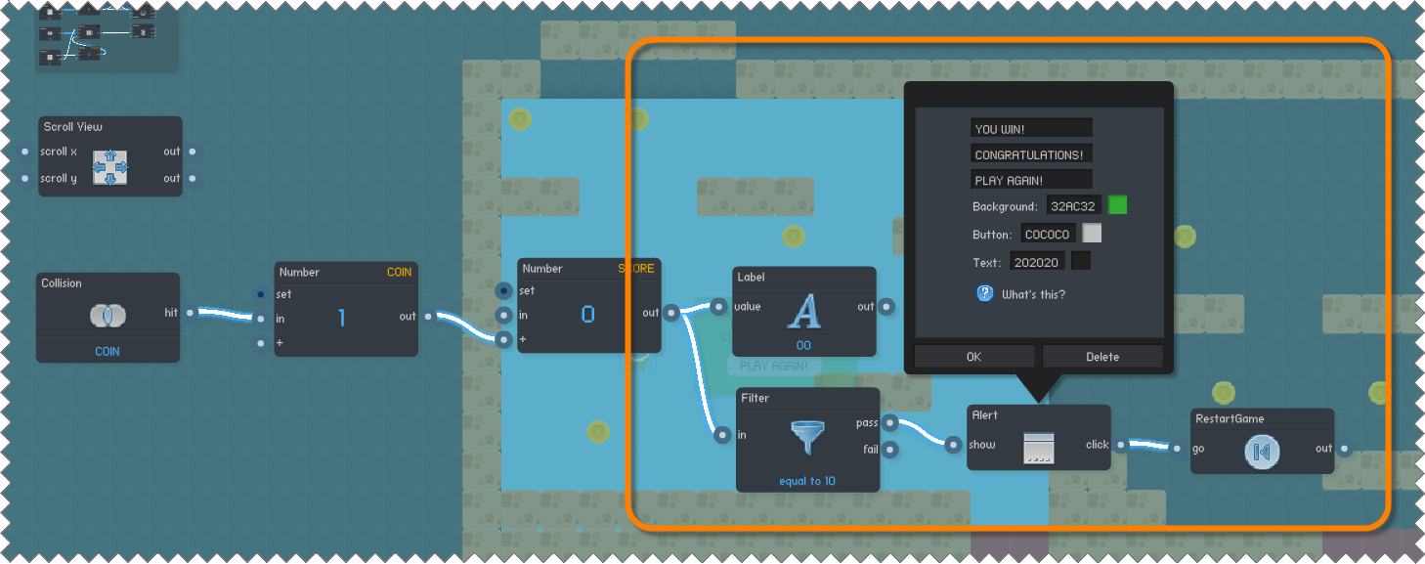
Add game win logic

Slide 24
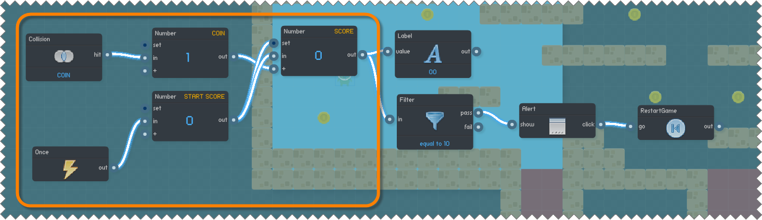
Reset the Score at STart

Slide 25
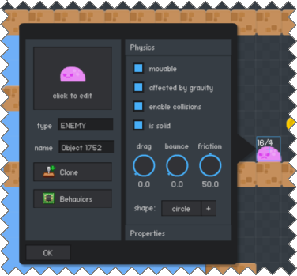
Create the enemy

Slide 26
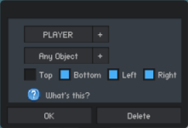
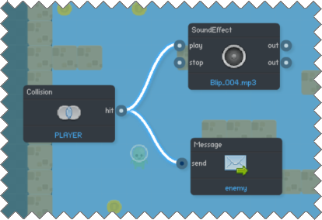
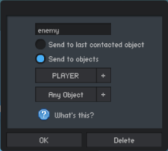
Send enemy message to player

Slide 27
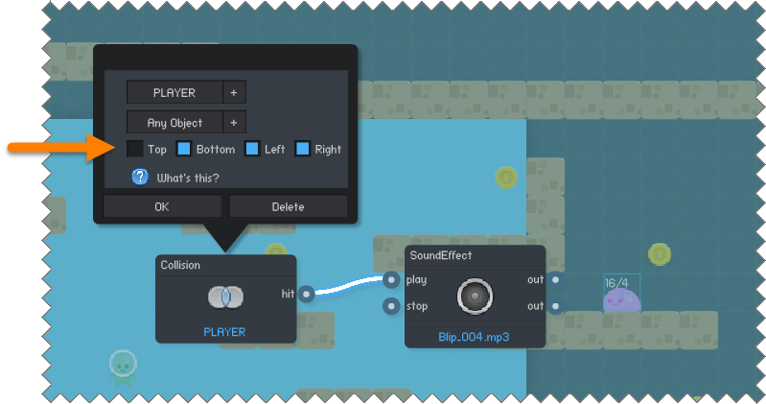
Play enemy collision sound
THIS COLLISION TRIGGER SHOULD ONLY FIRE IF THE ENEMY COLLIDES WITH THE PLAYER ON THE ENEMY’S SIDES OR BOTTOM, NOT THE TOP

Slide 28
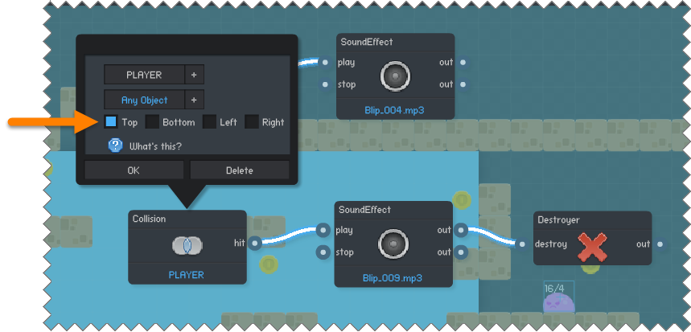
DESTROY ENEMY ON TOP COLLISION
THIS COLLISION TRIGGER SHOULD ONLY FIRE IF THE ENEMY COLLIDES WITH THE PLAYER ON THE ENEMY’S TOP (when the player “LANDS ON” the enemy)

Slide 29
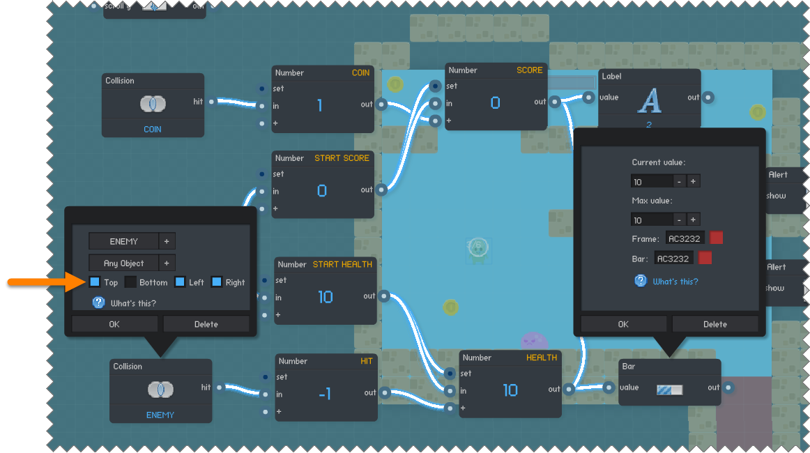
Hurt player on enemy collision
The player only gets hurt if it collides with the enemy on the player’s TOP or SIDES

Slide 30
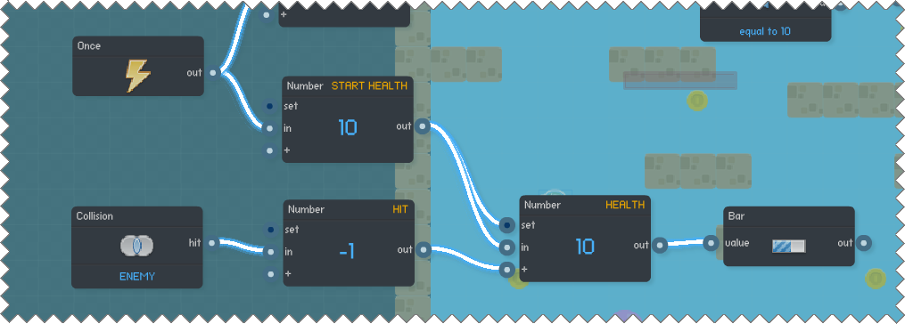
Reset health at game start

Slide 31
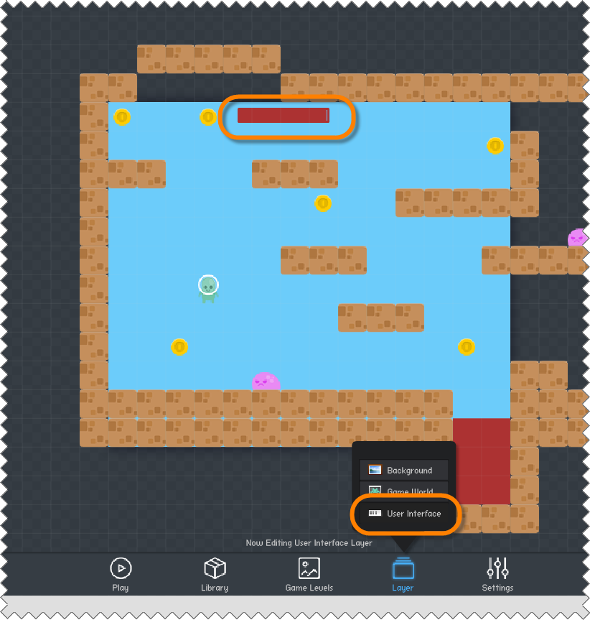
Position the health bar

Slide 32
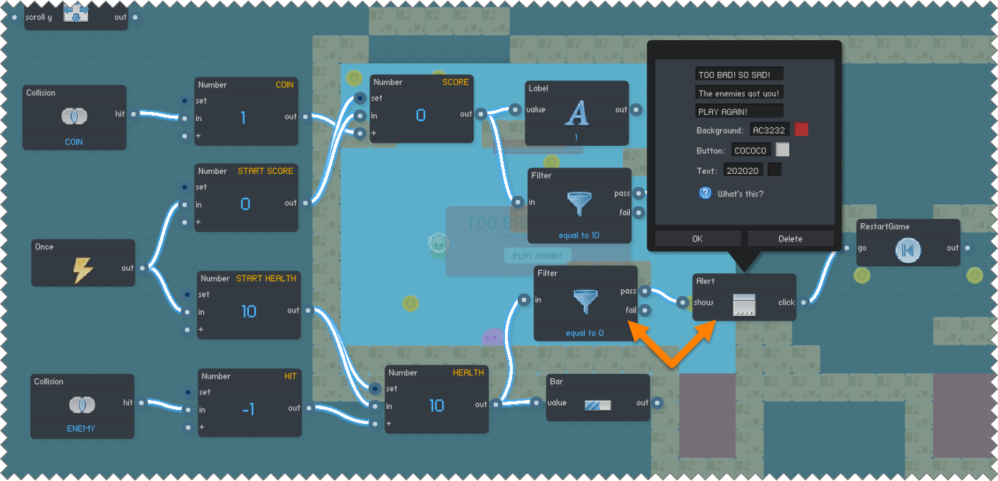
Add game over logic to player

Slide 33
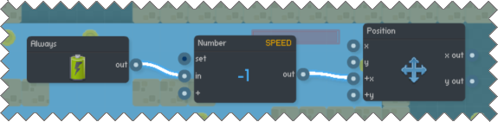
ADD ENEMY MOVEMENT

Slide 34
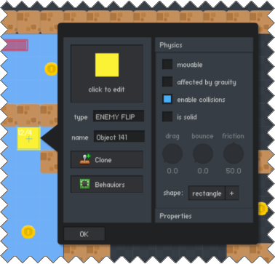
ADD ENEMY FLIP BLOCK

Slide 35
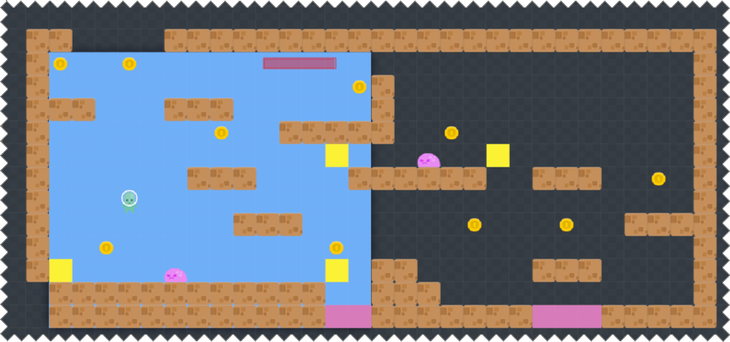
Place where enemy should “FLIP”

Slide 36
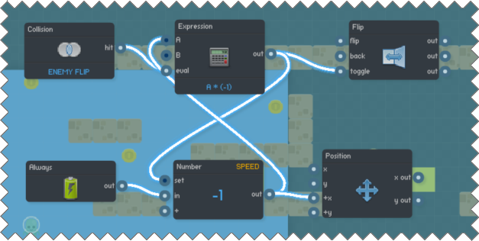
Add flip behavior to enemy

Slide 37
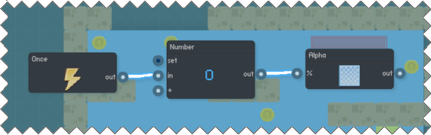
Hide enemy flip blocks at start

